Slide 1
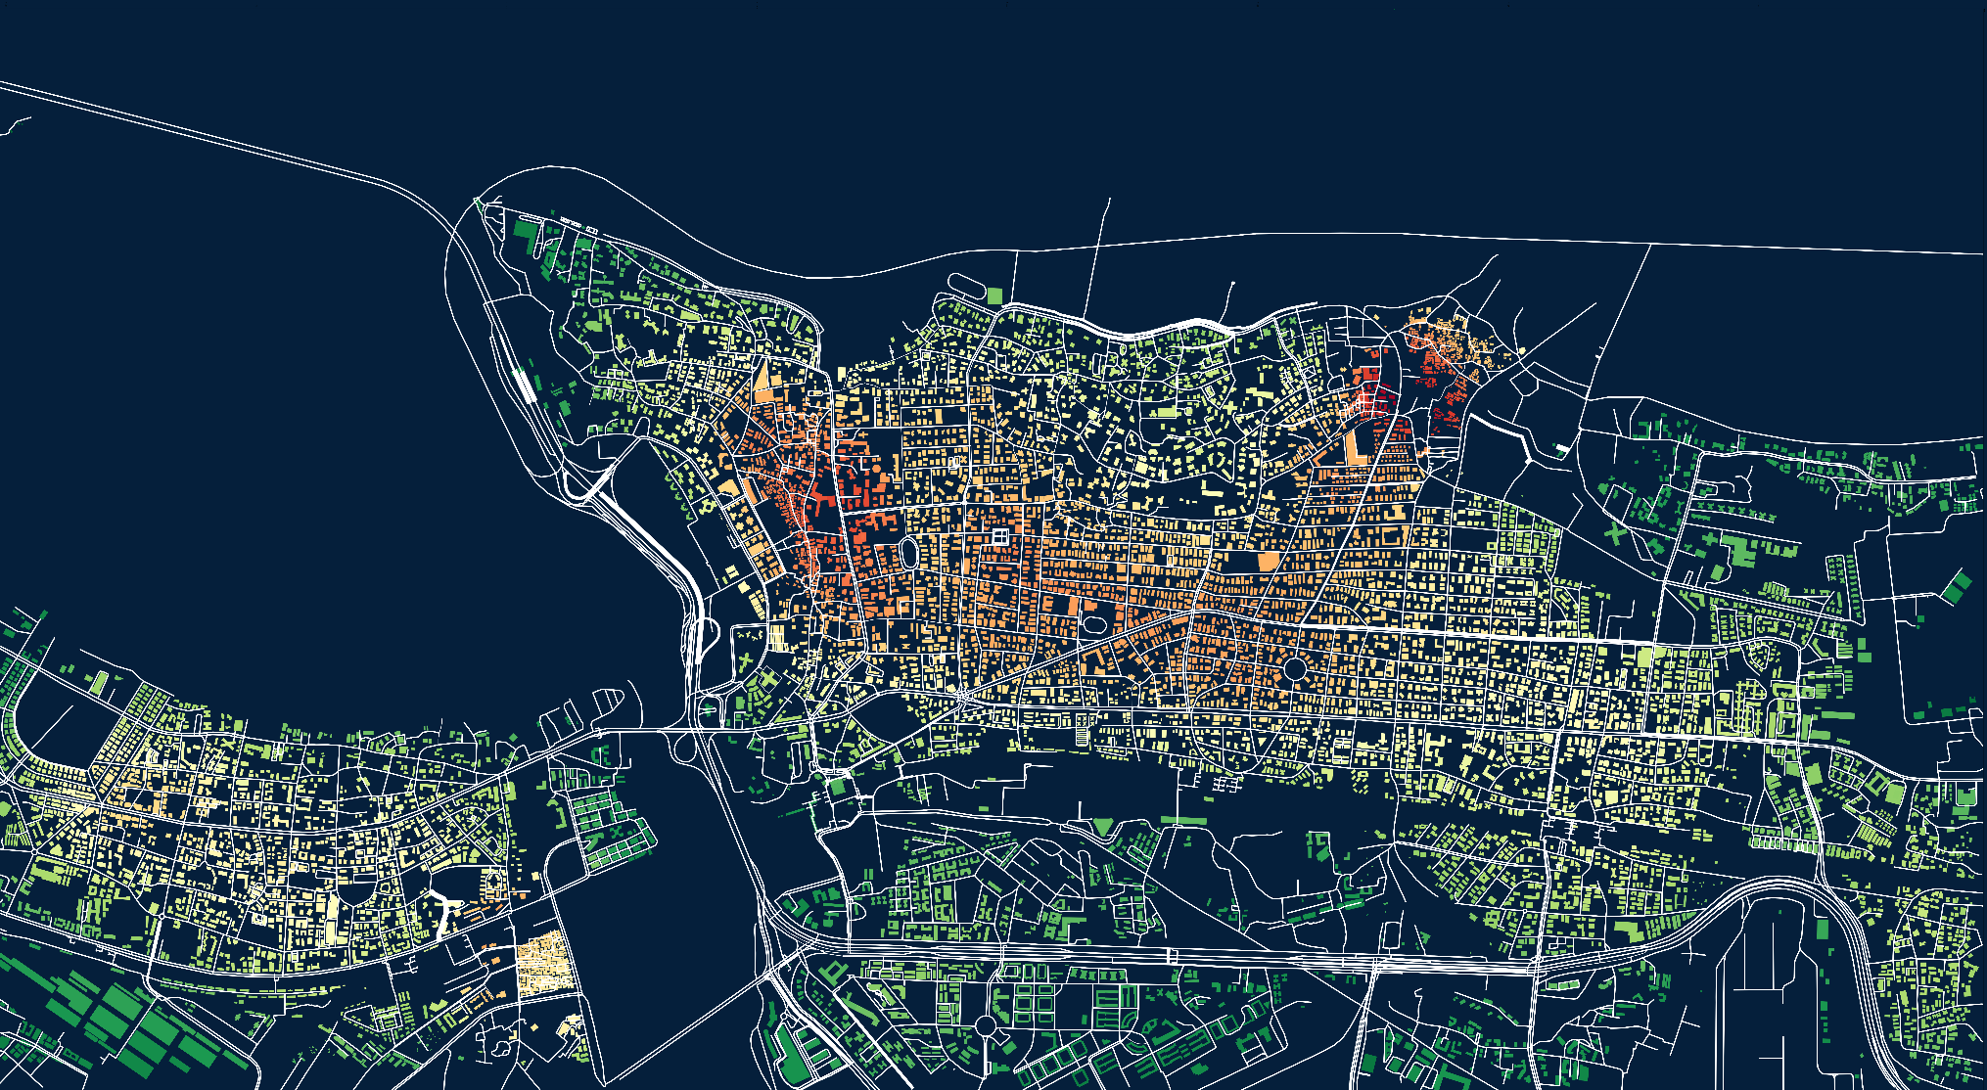
Mitigating urban floods
Thesis advisor:
German Otto Bodenbender
One level at a time
Team :
Aly Mahmoud
Christopher Mina
Farida Fidvi
Notes:
Hello all Our thesis project is Mitigating Urban Floods

Slide 2
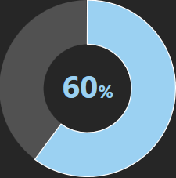
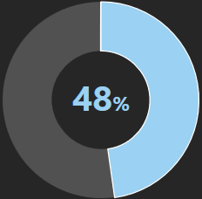
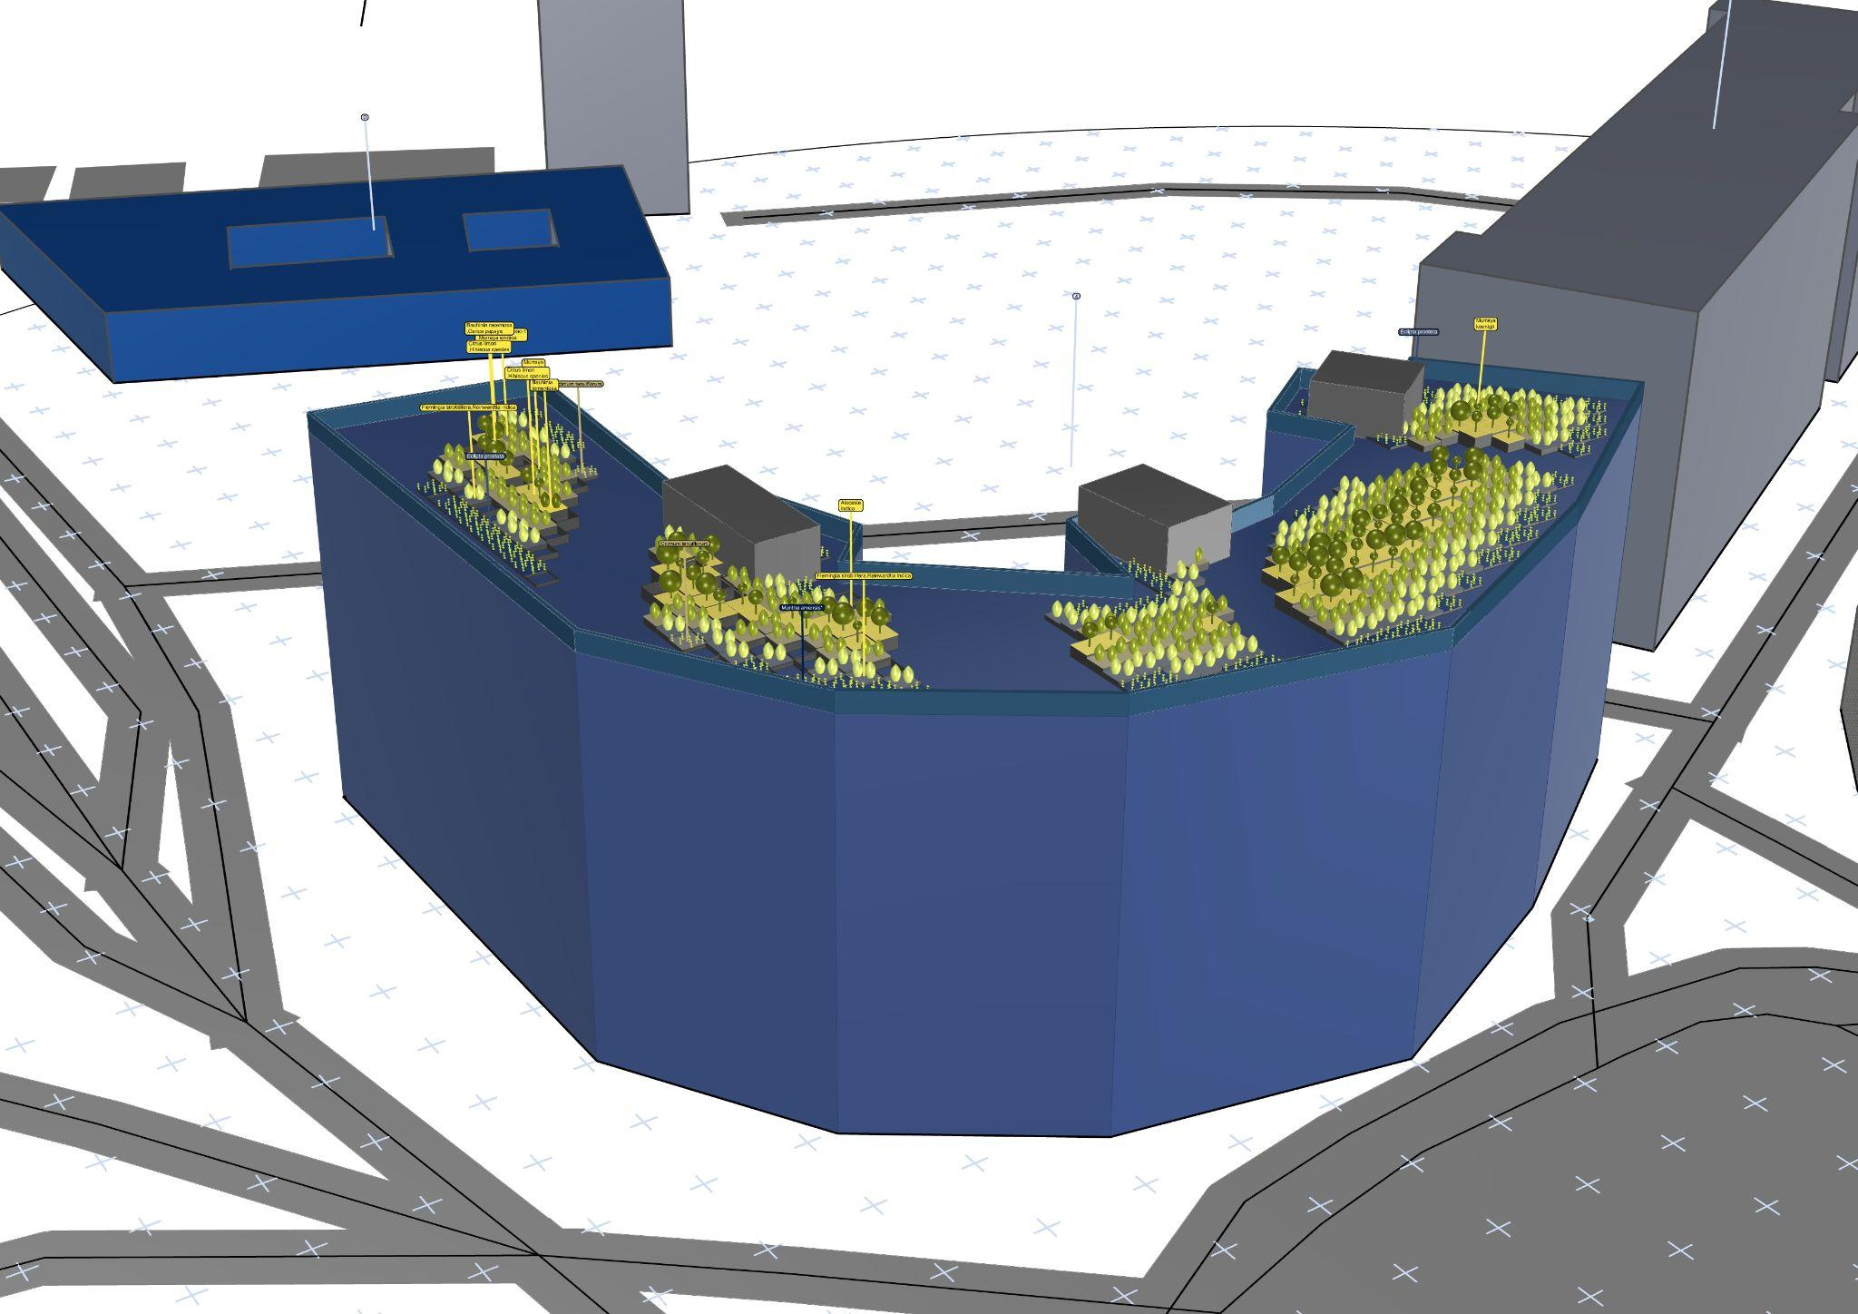
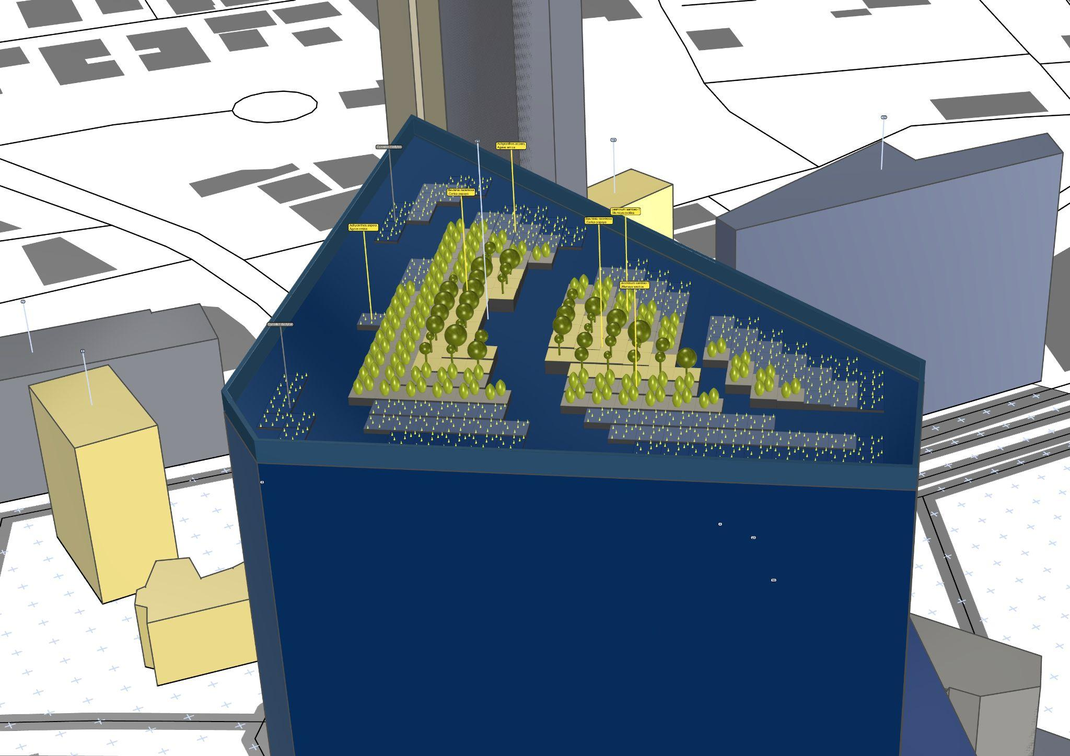
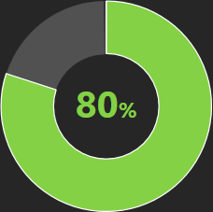
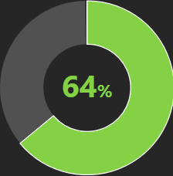
Mitigating urban floods
Mitigate Urban Flash floods by increasing the permeable surface areas.
Mainly through green roofs. Now let’s walk through the process.
Notes:
Heres a preview at the final results or what we intend to archive, we are developing a workflow for architects and urban designers to mitigate Urban Flash floods by increasing the permeable surface areas. Mainly through green roofs.

Slide 3
Exploring the whys
Notes:
Lets start exploring the whys

Slide 4
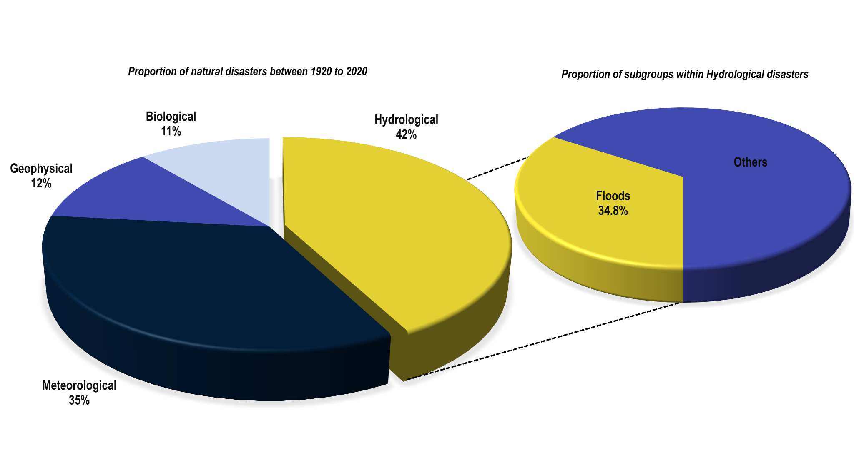
why
?
Floods
From 1920 to 2020, out of total 15,406 natural disasters, hydrological disasters have been the highest accounting for 42%, amongst which floods have the highest percentage of 34.8%.
Notes:
F- in the past years the number of hydrological disasters have been the highest amongst all natural disasters within which floods have the highest percentage

Slide 5
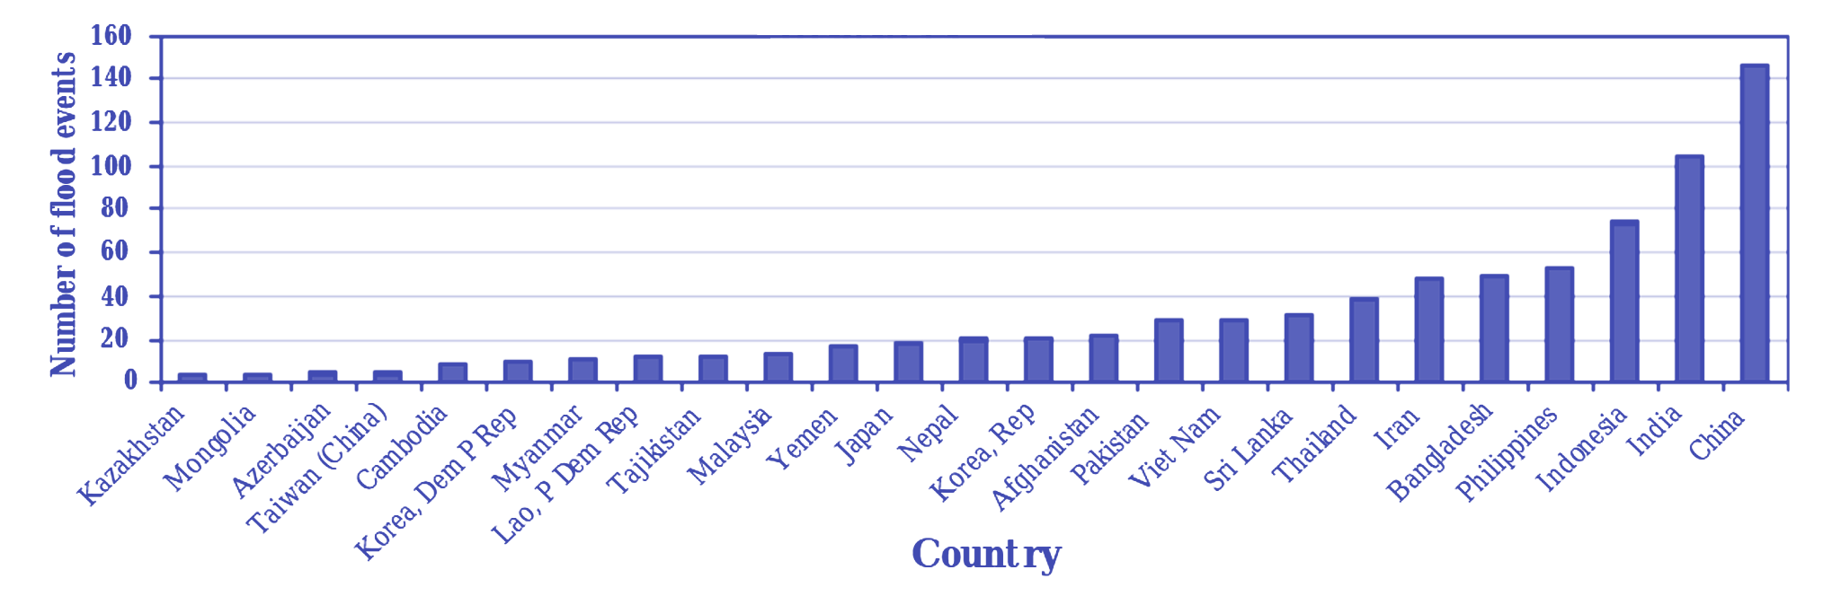
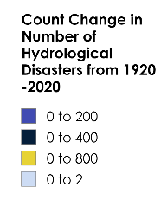
why
?
India
India is the second most affected country in Asia .
In India's 10 most populous cities 35% of new urban development from 2000-2015 within 20km of city center radius has been on low lying, vegetated , high rechange potential zones.
Notes:
Within which India is the second most affected country as 35% of its new development with the city limits has been in low lying, vegetated areas-F

Slide 6




why
?
Mumbai
Meteorological Factors
Concentrated heavy rainfall
Hydrological Factors
Surface Runoff >> Soil Infiltration rate
Anthropogenic Factors
Encroachments of water bodies
Outdated Grey Infrastructure
Stormwater drainage lacks capacity
Average precipitation of 800mm/hr in July in Mumbai
Loss of 40% mangroves between 1995 to 2005
Increase in built-up land by 59.66% from 1995 to 2009.
25% loss of water bodies
Antique drainage system capable of carrying only 25mm of water/hour
Notes:
On the left we can see what cause urban floods and as we can see in Mumbai all of them are present, like concentrated heavy rainfall, loss of natural mangroves and water bodies, increased built up and outdated drainage infrastructure

Slide 7
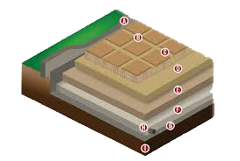
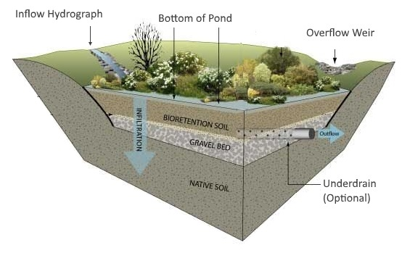
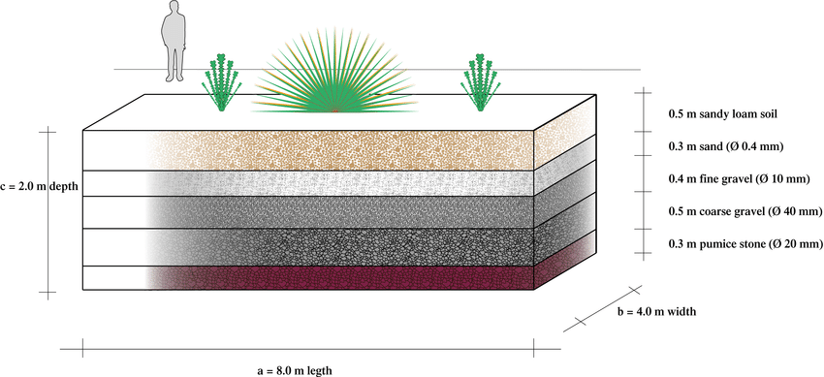
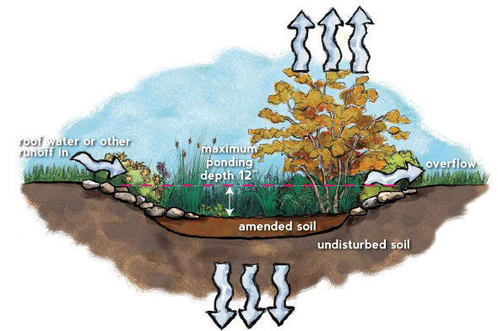
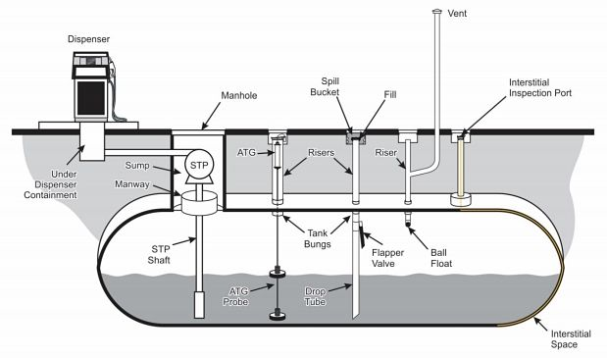
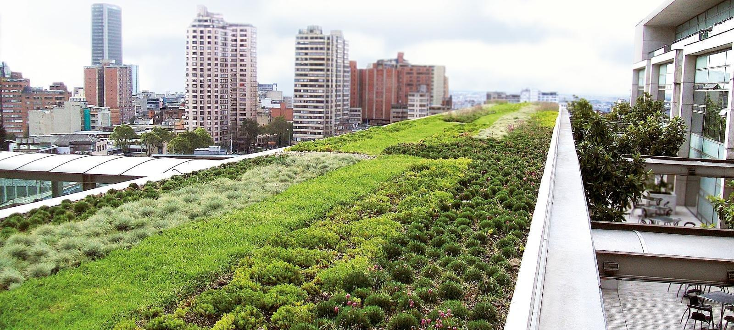
State of the art
Sponge Cities (Wuhan, China)
Aims to reduce flooding and improve water supply security in urban areas
Results indicated that the best-performing sponge city scenario with a 14.8–46.8% is green roofs (area ratio) +10% herbaceous basins +10% permeable pavements.
Permeable
Pavements
Retention
Ponds
Rain
Gardens
Underground
Storage Systems
Bioretention
Green Roof
Notes:
To have a better understanding of the existing solution,!!!! we looked into other state of the art projects which were the sponge cities which aim is to reduce flooding, used different type of systems.!!!! In which green roof came out as a best performing

Slide 8
Sustainable Infrastructure | Cost per Square Meter (₹) | Resource Intensity | Manpower | Noise Disturbance | Neighborhood Disturbance
Permeable Paving | ₹2,500 - ₹5,000 | Low | Low (3-5 people) | High | High
Retention Ponds | ₹2,500 - ₹4,000 | Medium | Medium (5-10 people) | Medium | Medium
Bioretention Systems | ₹6,000 - ₹9,000 | Medium | High (10+ people) | Medium | Medium
Rain Gardens | ₹3,000 - ₹5,000 | Medium | Medium (5-10 people) | Low | Low
Underground Storage Systems | ₹6,000 - ₹8,000 per cubic meter | High | High (10+ people) | High | High
Green Roofs | ₹2,500 - ₹25,000 | Low High | Low (3 people) High (10+ people) | Medium | Low
Notes:
To even go deeper we compared other aspects like

Slide 9
Sustainable Infrastructure | Cost per Square Meter (₹) | Resource Intensity | Manpower | Noise Disturbance | Neighborhood Disturbance
Permeable Paving | ₹2,500 - ₹5,000 | Low | Low (3-5 people) | High | High
Retention Ponds | ₹2,500 - ₹4,000 | Medium | Medium (5-10 people) | High | Medium
Bioretention Systems | ₹6,000 - ₹9,000 | Medium | High (10+ people) | Medium | Medium
Rain Gardens | ₹3,000 - ₹5,000 | Medium | Medium (5-10 people) | Low | Low
Underground Storage Systems | ₹6,000 - ₹8,000 per cubic meter | High | High (10+ people) | High | High
Green Roofs | ₹2,500 - ₹25,000 | Low High | Low (3 people) High (10+ people) | Medium | Low
Notes:
We notice that in some cases there were more issue !!!! towards the neighborhoods like permea paving and retention ponds But in other cost was the main issue like Bioretention and underground storage systems issue A good balance was found with green roof

Slide 10
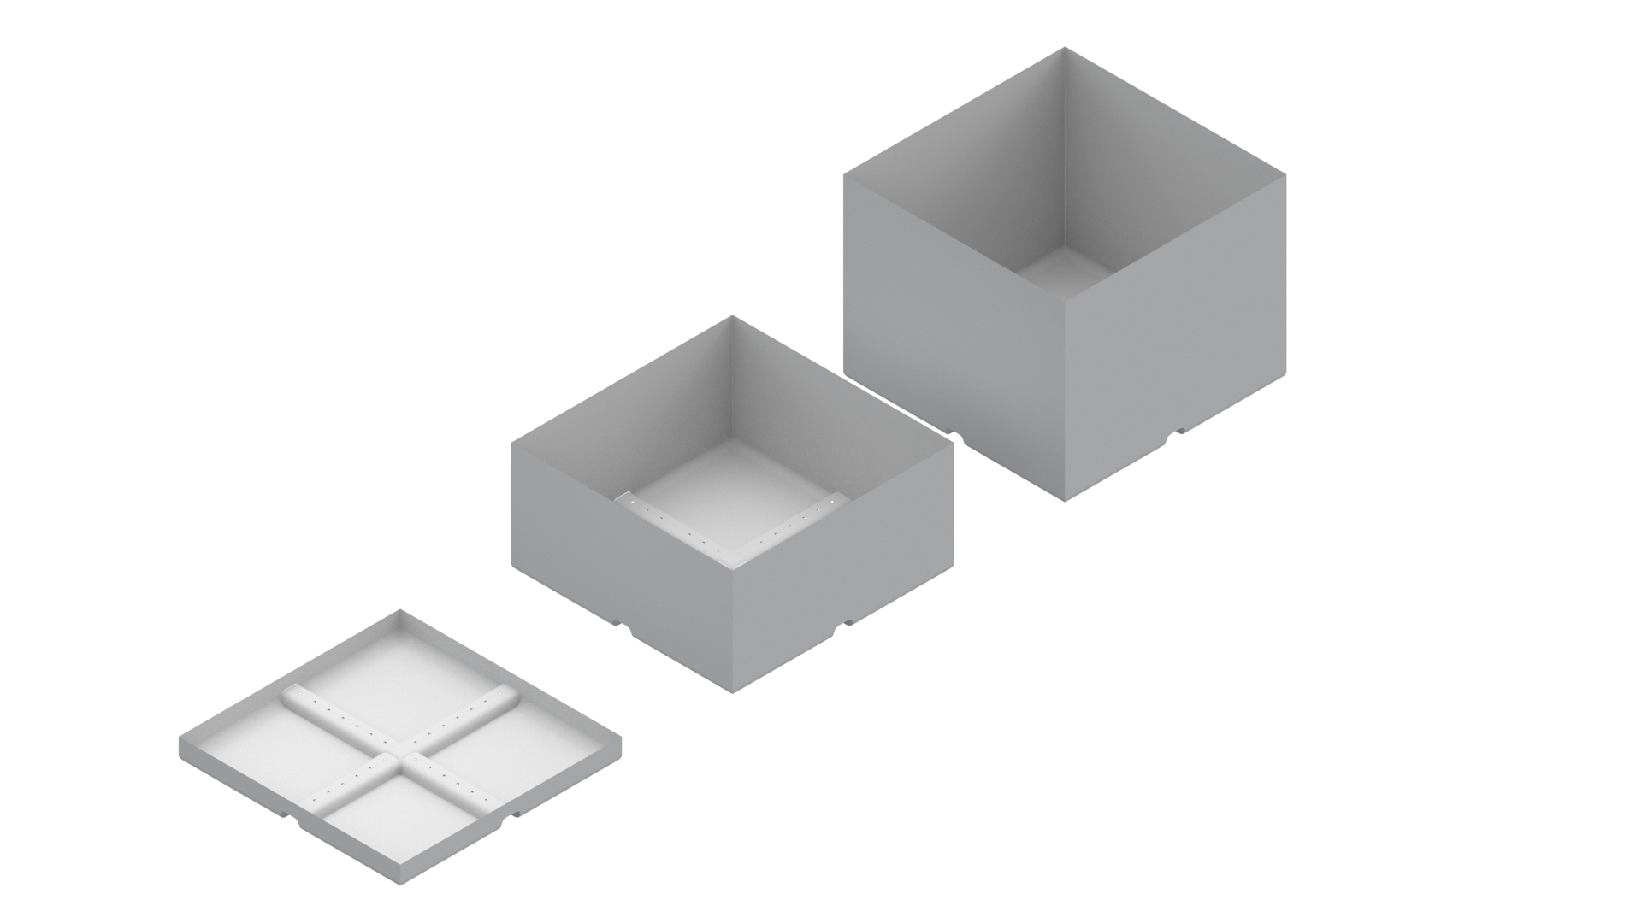
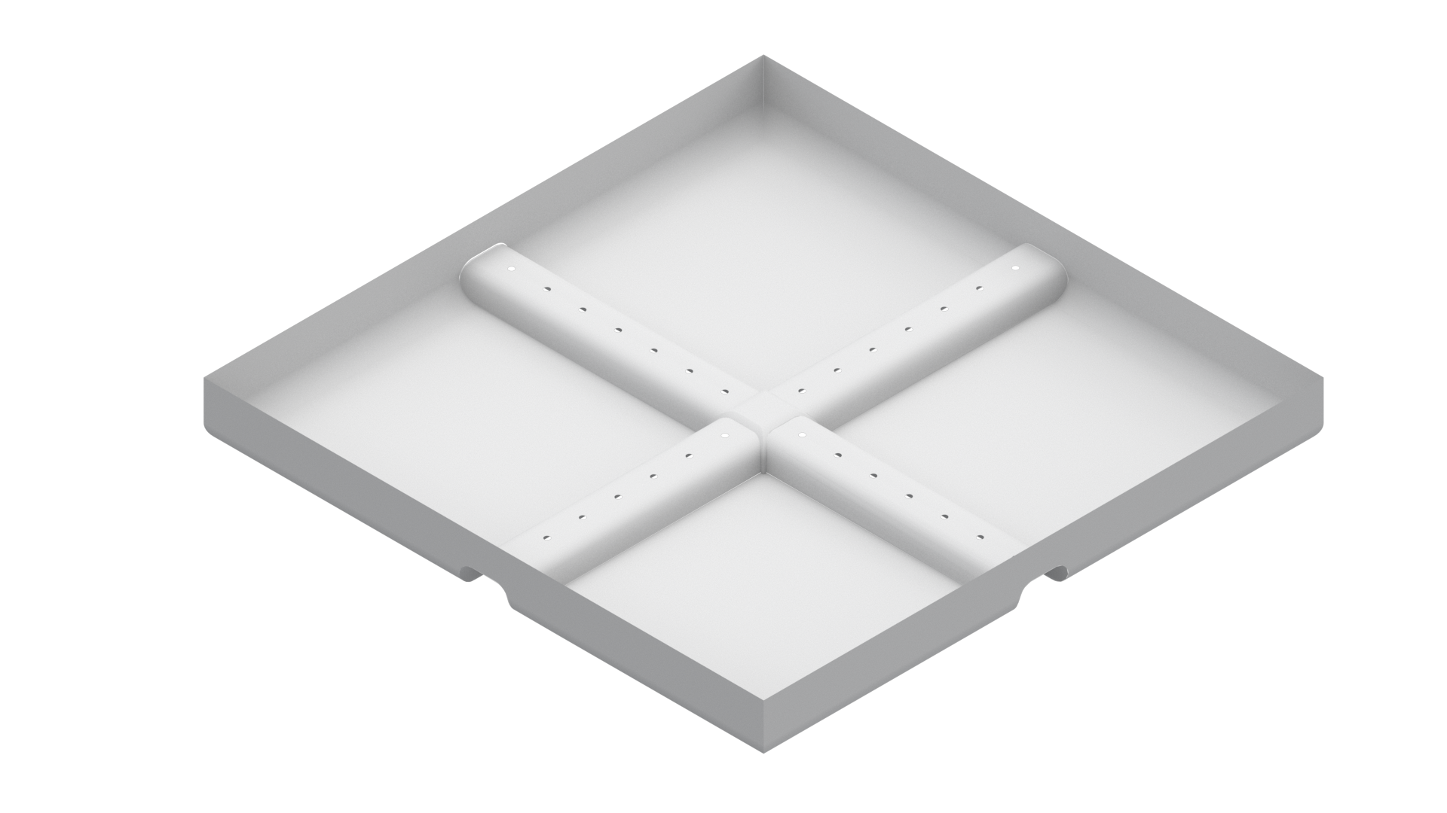
Green roof
Modularity
This system consists of components that are pre-assembled in trays, designed for easy placement on roofs.
Notes:
The modules are designed with higher soil depth in the center, tapering towards the edges, based on remapped values from the distances between each module's center and the roof's edge.

Slide 11
Computational methodology
Notes:
Moving on to our computational Methodology

Slide 12
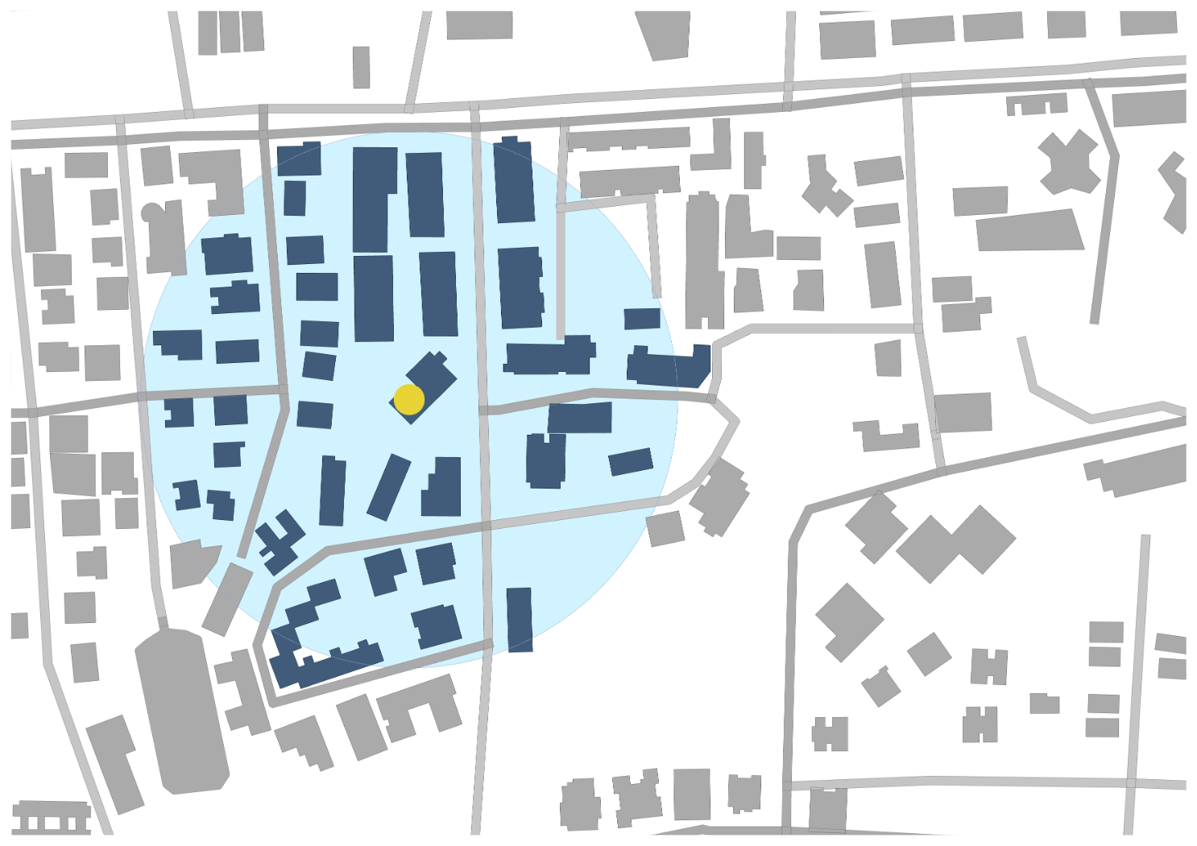
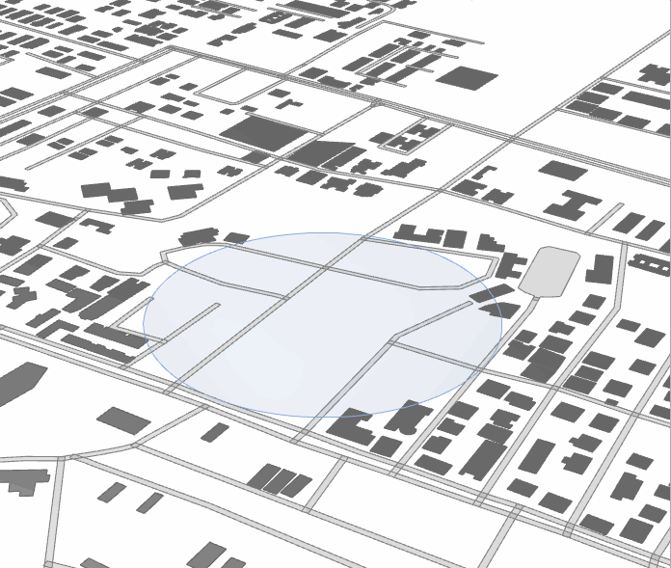
Setting Heights
Location and Radius
Notes:
Firstly a location and a radius are set for a selected region |||||| secondly the building heights are set

Slide 13
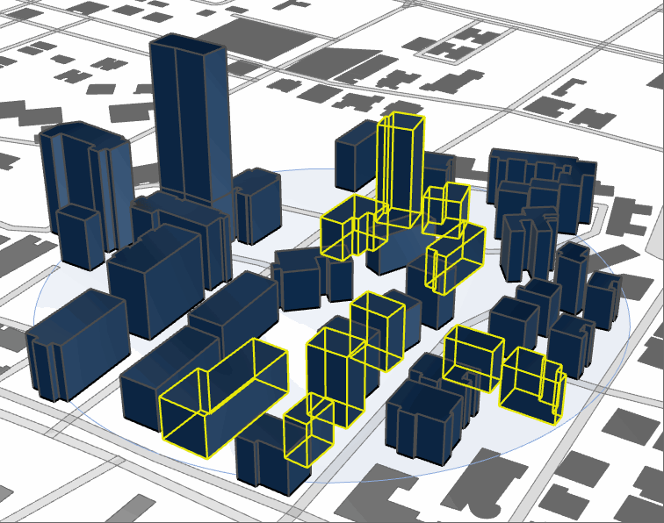
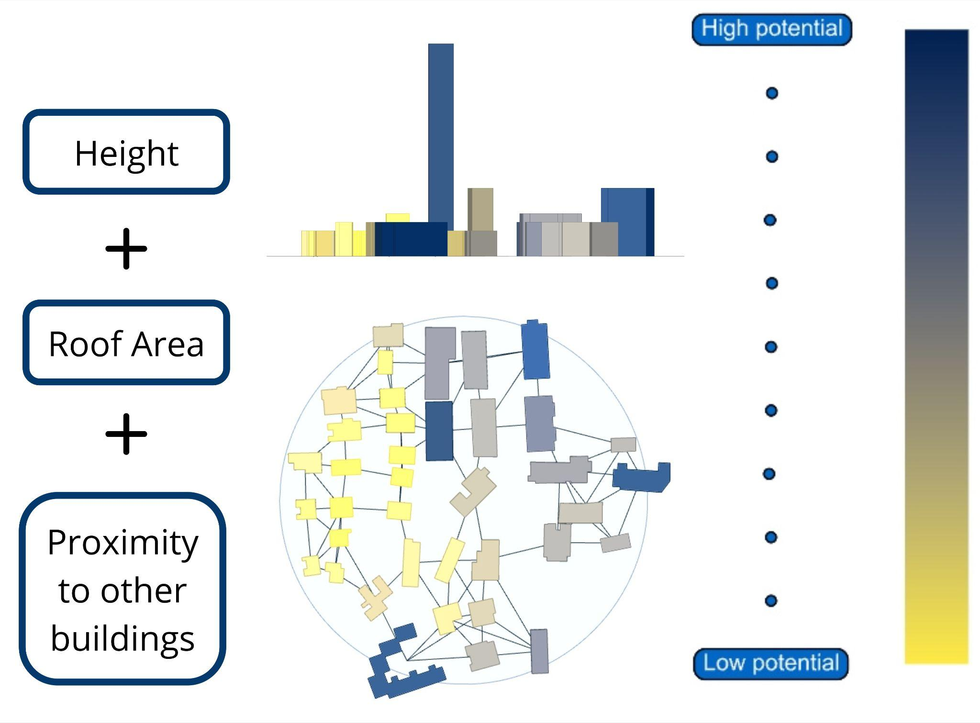
Runoff Reduction potentiality
Roof typology Segregation
Notes:
Then segregating roof typologies pitched roofs and flat roof
|||| after that we colour code our buildings according to their runoff reduction potential

Slide 14
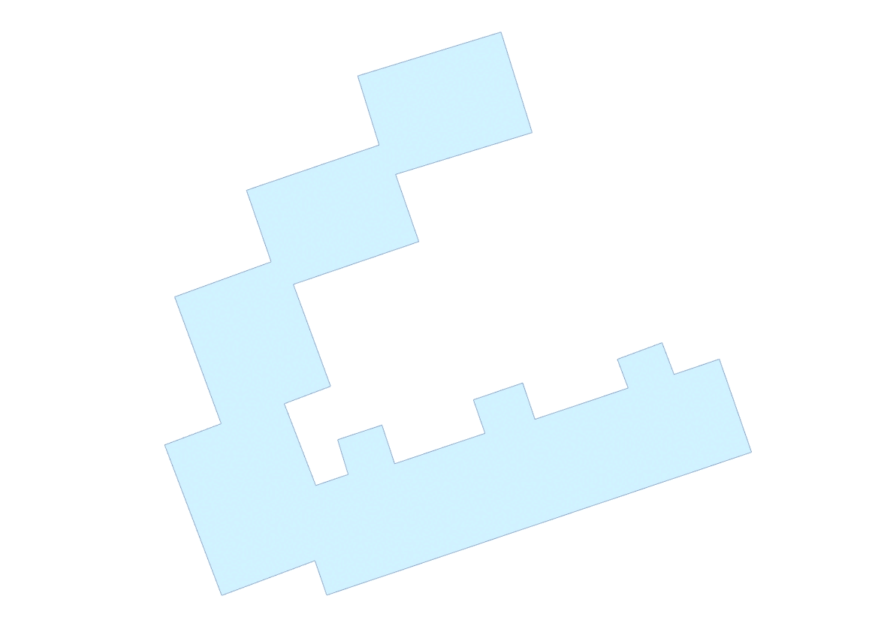
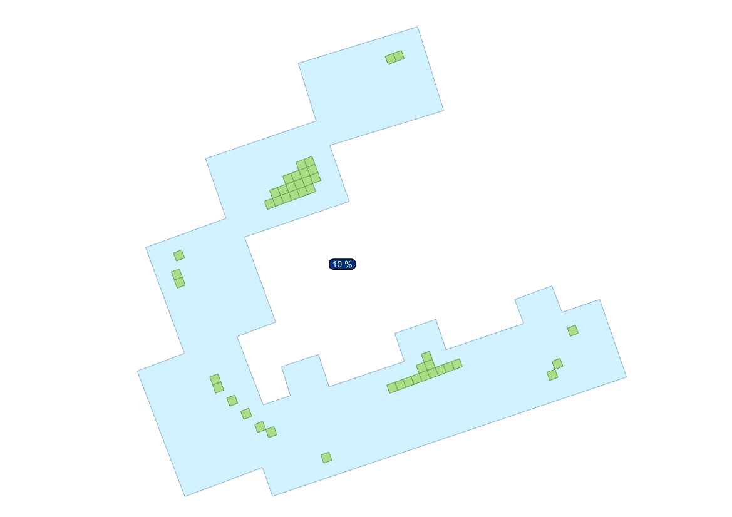
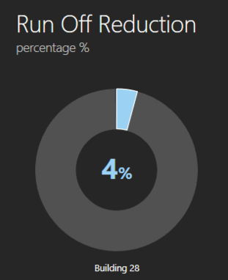
Runoff calculation readings
Usable Roof percentage
Notes:
Next is the flexibility of setting a usable roof percentage |||||| and getting the runoff calculation readings.

Slide 15
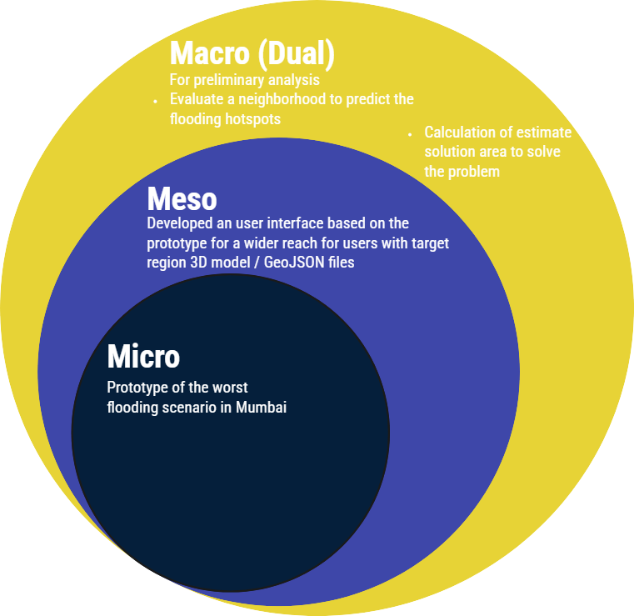

Project focus and scale
Widening of scope and hence users

Slide 16

Project focus and scale
Widening of scope and hence users
Notes:
The project focus and scale
For the micro level we developed a prototype for the worst case scenario in Mumbai, this research would be useful for other urban enthusiasts or government policy makers to understand the direct impact of the proposed solution.

Slide 17
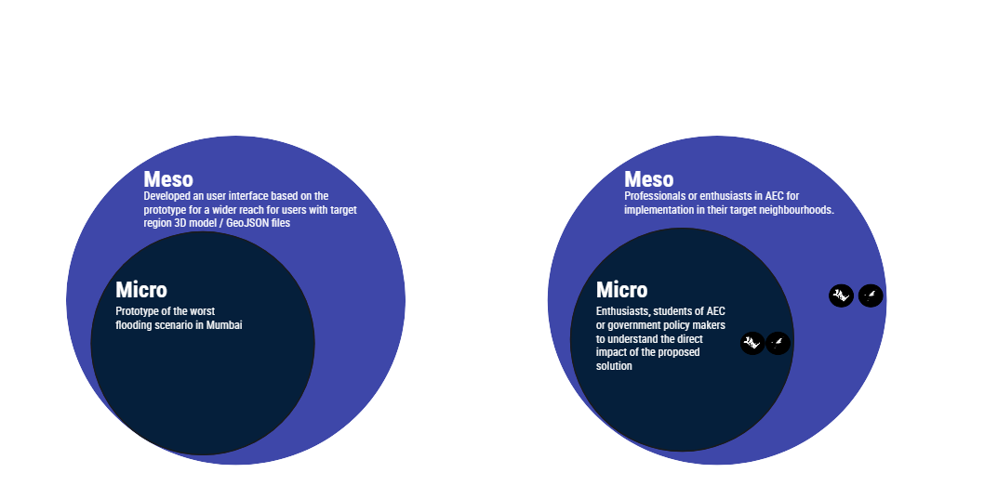
Project focus and scale
Widening of scope and hence users
Notes:
We then broadened our scope to develop an interface where the professionals in AEC industry can evaluate their region using either a 3D model of a GEOJSON of the area.

Slide 18
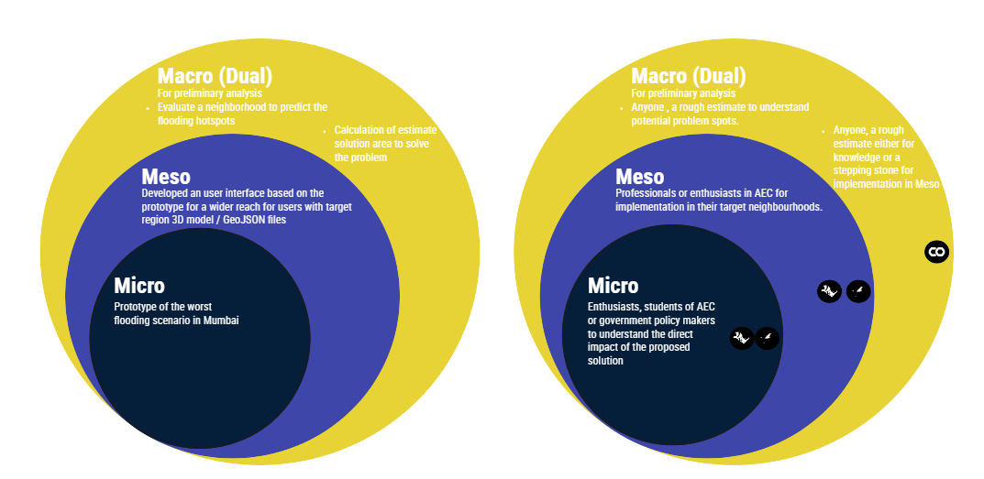
Project focus and scale
Widening of scope and hence users
Notes:
And then we decided to further broaden our scope for dual reasons,first where anyone can evaluate a neighbourhood to see where the potential flood hotspots could be and the second being a rough estimate of the green roof required to attain a target surface runoff reduction by differing the input parameters.

Slide 19
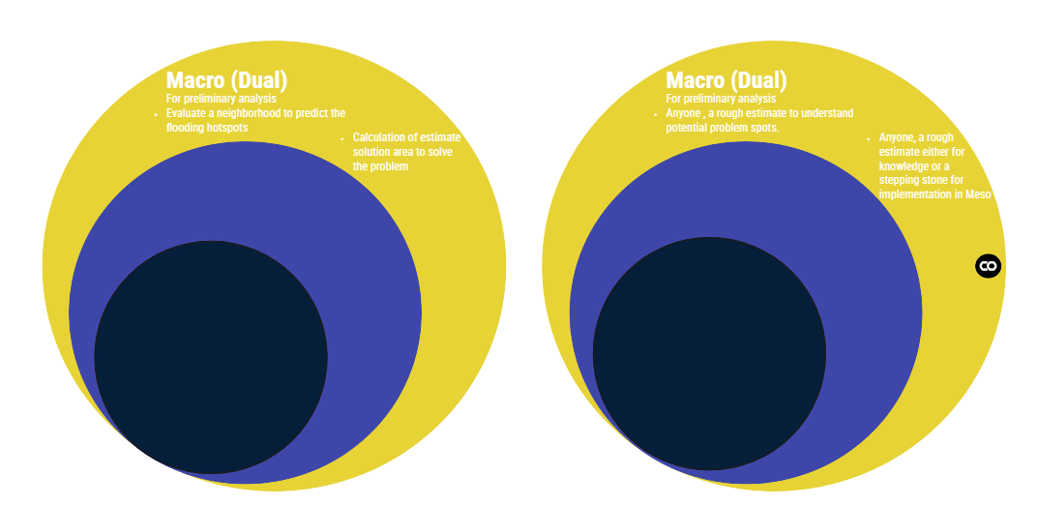
Notes:
First we focus on the macro scale of estimating the surface runoff reduction percentage with just different input values

Slide 20
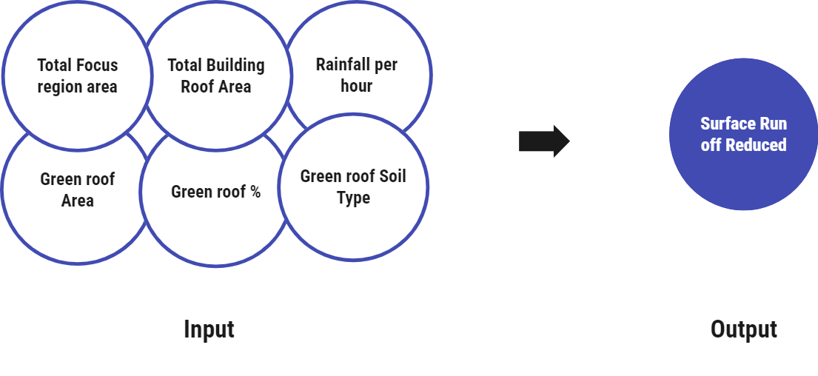
Macro Level
Supervised Machine Learning Model
Trained the model on 1445 datasets across flood prone areas in Mumbai
Notes:
For which we used supervised machine learning, where the input parameters were! Total focus region area ! total building roof area, rainfall per bhour, green roof area, green roof % as well as green roof soil type and the! Output being! The total surface runoff percentage reduced

Slide 21
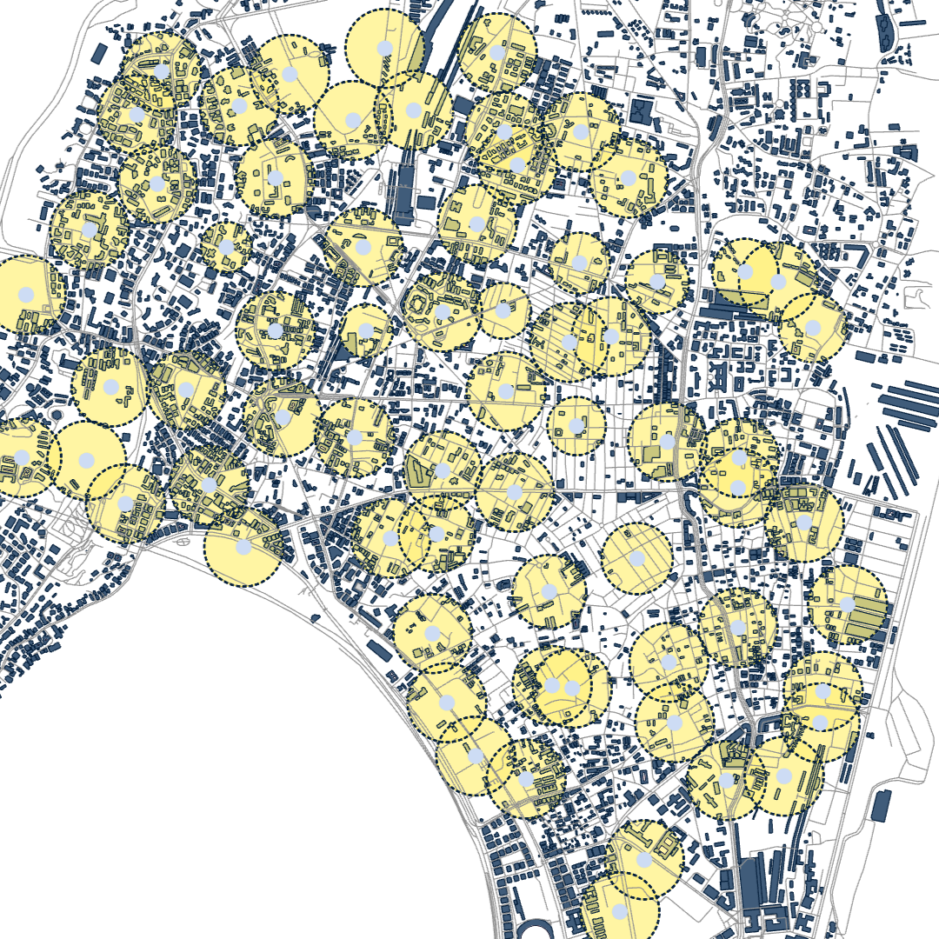
Macro Level
Supervised Machine Learning Model
Trained the model on 1445 datasets across flood prone areas in Mumbai
Notes:
For which we used supervised machine learning, where the input parameters were! Total focus region area ! total building roof area, rainfall per bhour, green roof area, green roof % as well as green roof soil type and the! Output being! The total surface runoff percentage reduced

Slide 22
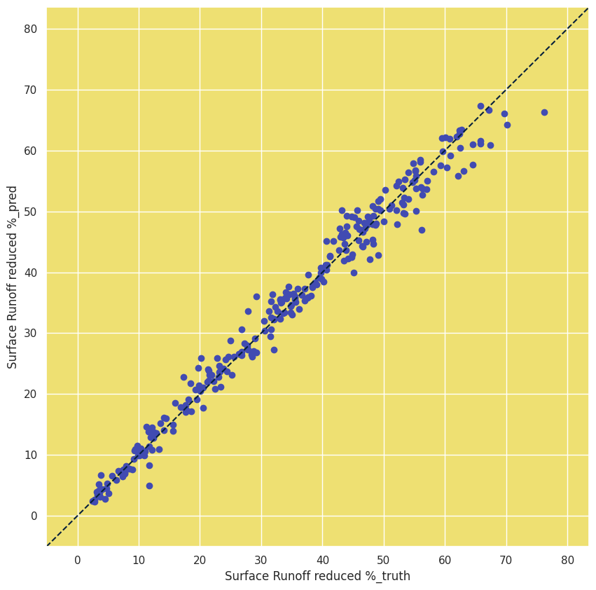
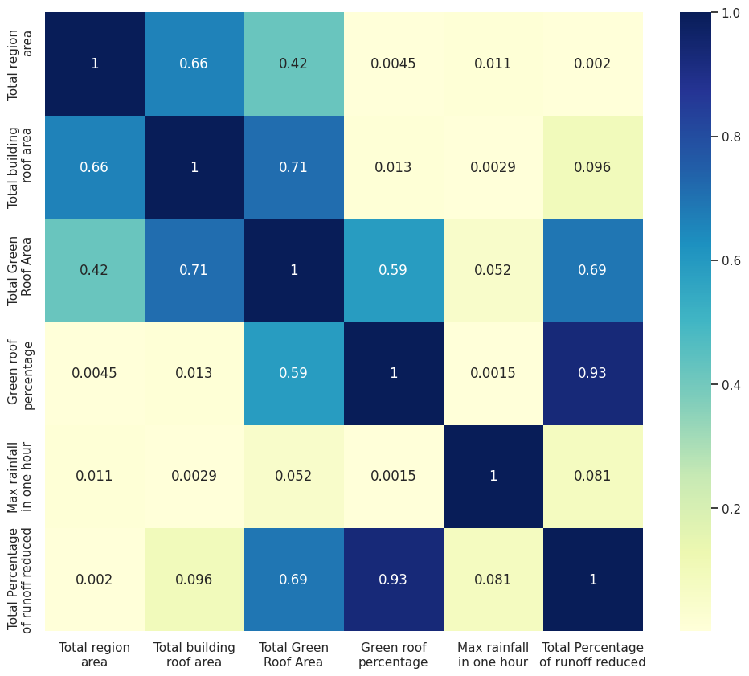
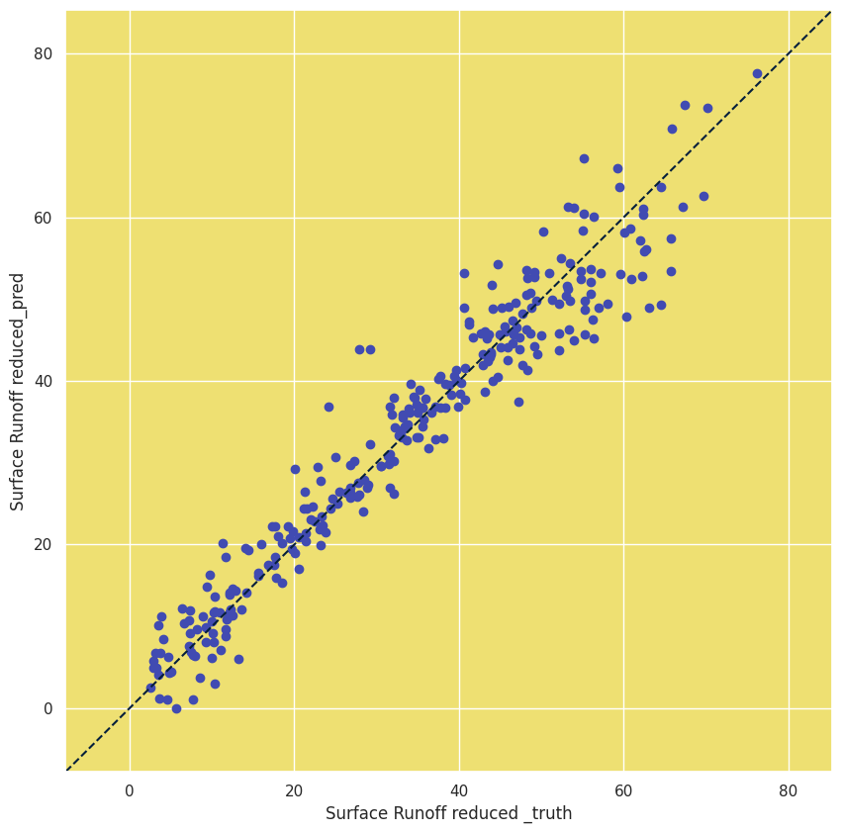
Macro Level
Supervised Machine Learning Model
Linear Regressor (Model Score R^2 :0.936
Notes:
We trained the model on 1445 datasets, and with the correlation map it was clearly seen that the runoff reduction does have a very good relation with the green roof percentage indicating potential good results, we first trained a linear regression model with the inputs label encoded and standard scaled.The model score was 0.936 and when the truth and predicted results were plotted a clear diagonal trend can be seen.

Slide 23
Macro Level
Deployed Model - XGBoost Regressor
Hyperparameters:
Learning rate:0.2
Maximum depth:3
Number of estimators:300
R^2 Score:0.981
Notes:
For an enhancement in results we trained the XGboost regressor model which the hyperpraramters found after a grid search being as learning of 0.2, maximum depth of 3 and number of estimators as 300, the model score improved to 0.981 and the diagonality in the graph was stronger and hence this model was used for deployment in our interface which we see next under primary investigation

Slide 24
Notes:
Moving on to the meso scale and the Ui part

Slide 25
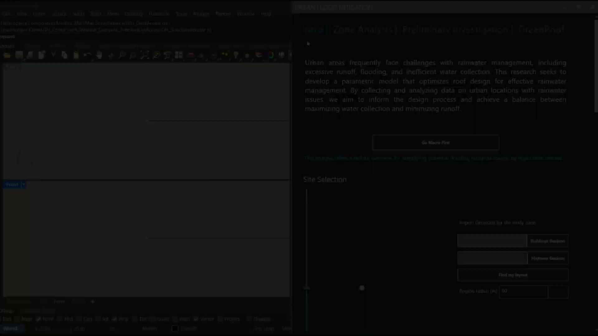
Notes:
Intro tab: 50 sec
Go Macro First : ‘first is the intro tab by clicking on the Go macro first (optional) button you are redirected to a colab notebook, where you can add your selected site Geojson files downloaded from overpass turbo from the link attached, and you get a plot showing the most dense urban spots.’ 20sec
Uploading GeoJSON Files. ‘Uploading Geojson files again on the User interface’ 5 sec
Moving to the location and adjusting the radius. ‘Now we can move to the dense hotspots and select the region radius’ 5 sec
Refining the context: ‘ refining the context by adjusting heights according to the numbering tags to get realistic heights’ ‘— bake !’ ‘and separate pitched roofs on a separate layer.’ 15 sec
Zone analysis tab: 25 sec
Analytical values for the zone: ‘following that pressing the start button in the zone analysis tab analytics like selected area, building count, built and non-built up area as well as the existing estimated runoff volume are calculated according to the max rain fall m/h input’
Preliminary investigation tab: 15 sec
A machine learning deployed model: ‘the preliminary investigation tab a separate integrated tool is a machine learning deployed model that predicts a preliminary investigation on the possible runoff reduction.’
Green Roof tab: 1:25
Generic Green roof: ‘Last but not least our green roof tab, you either go with a generic or a design method, in the generic method, parameters like usable roof percentage, grid size or container size, group division and location according to the edge can be adjusted and a preview button to reduce computational time’ 25 sec
Design your roof: ‘ for the design method the target is to mimic realistic roof situations by adding obstacles (for now it's only point or rectangular ones)’ 20 sec
LOADS: ‘for both methods the allowed additional dead load is added for each building, automatically adjusting the container height.’ 10 sec
Outputs : ‘as an output for each, either Generic or design methods we get the calculated green roof and runoff reduction percentage.’ 13 sec
Cost estimate overview: ‘a combination of material costs for the modular container can be manually set (the presented prices are random).’ 8 sec
Visuals part: ‘the final step visualizes the Radiation and soil depth after adding an EPW weather file,,,,,,,, according to the previous outputs a selection of vegetation is suggested. Considering the locally used Greenery.’ 17 sec

Slide 26
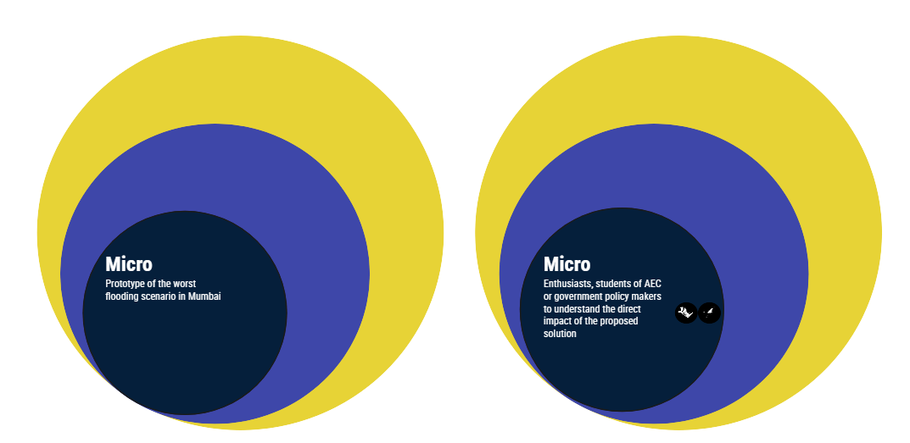
Notes:
For our micro level we tested our prototype on the worst case flooding scenario in Mumbai

Slide 27
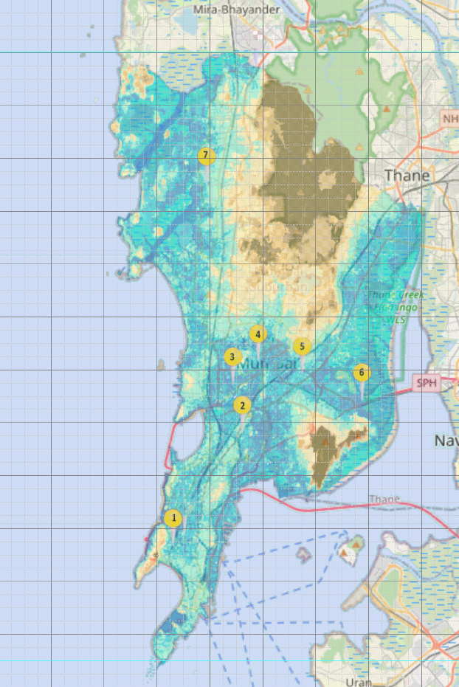
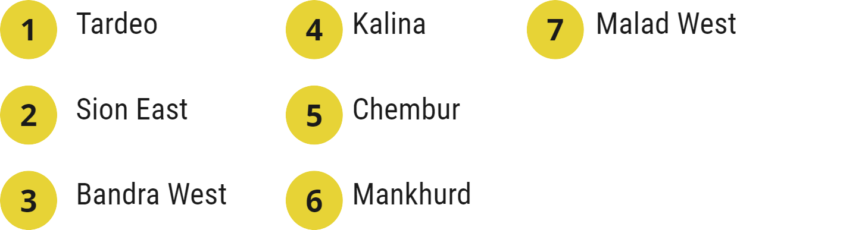
?
where in Mumbai
Selection of Focus area for prototype testing
Flooding hotspots as mapped in real time by source.
(considering ones which are OSM readable)
Notes:
As per historical data,these are the 7 flooding hotspots in Mumbai, we delved deeper into them to understand which might be the worst in terms of different urban criteria

Slide 28
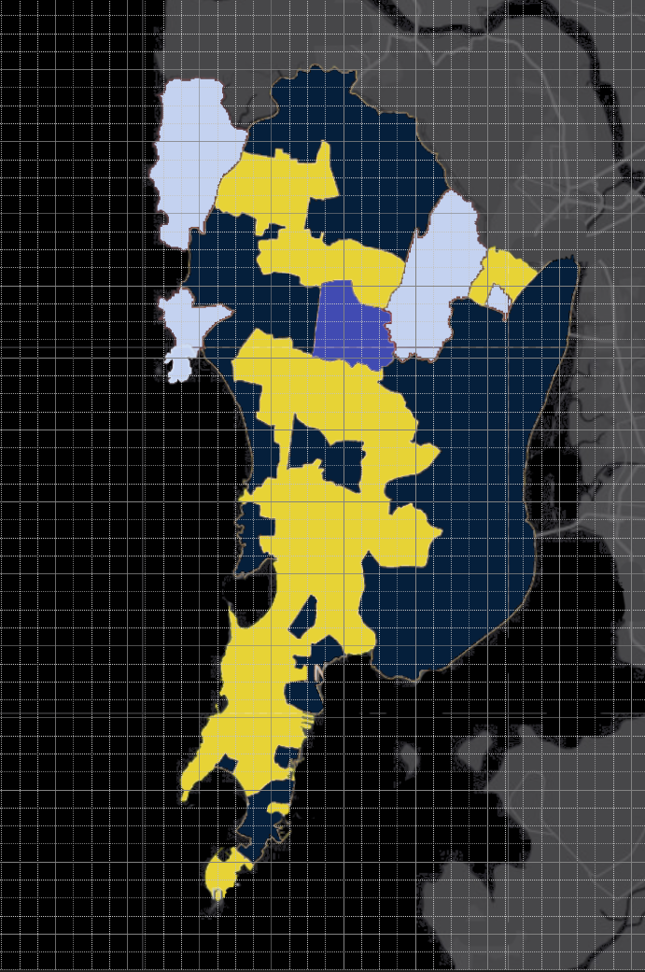
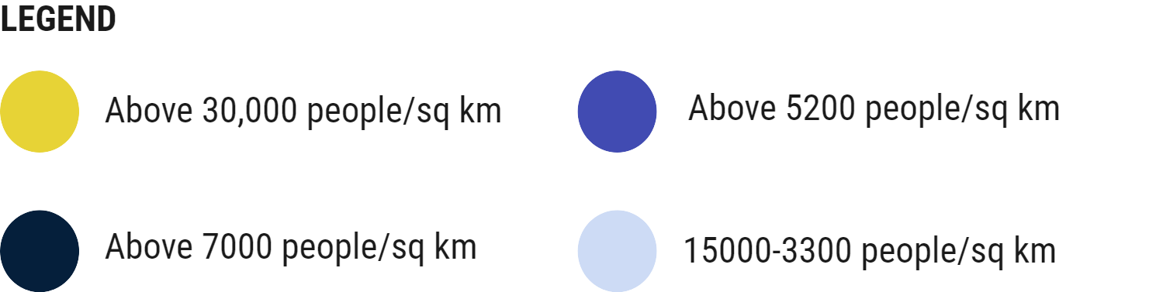
?
where in Mumbai
Selection of Focus area for prototype testing
Population census data
An approximate measure of urban density
Number of people affected by the floods

Slide 29
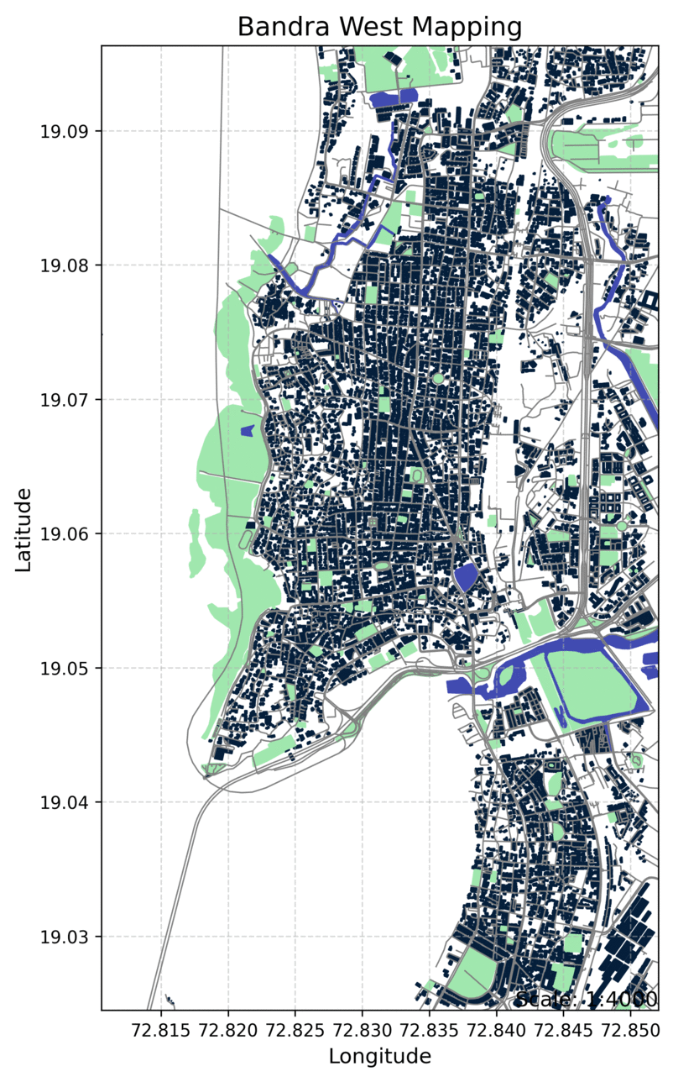
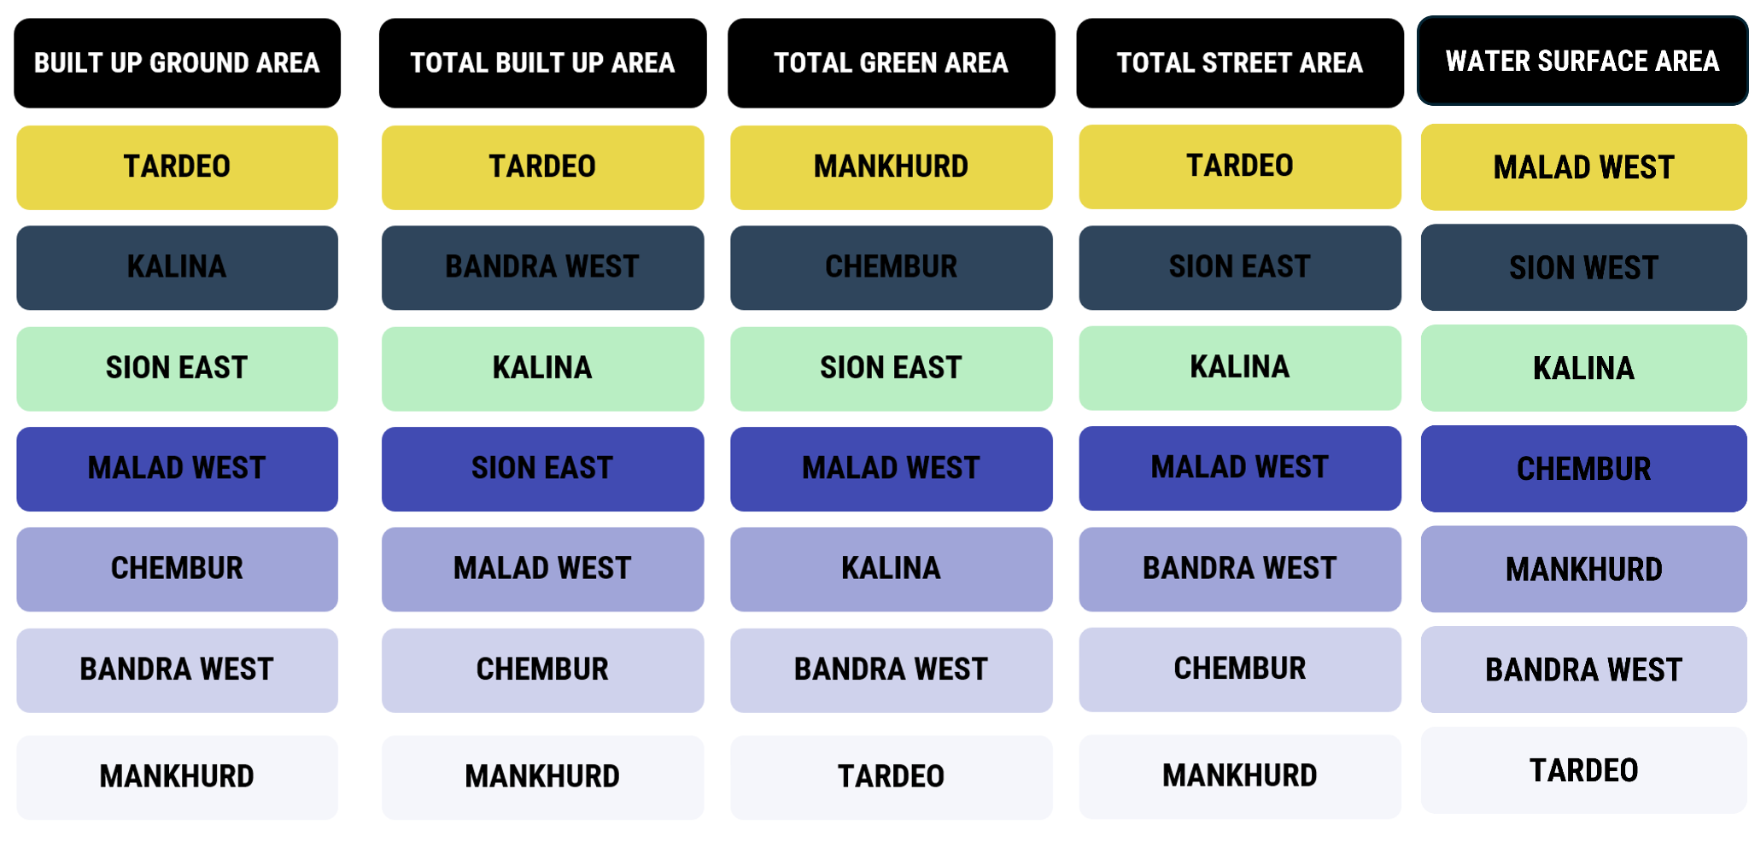
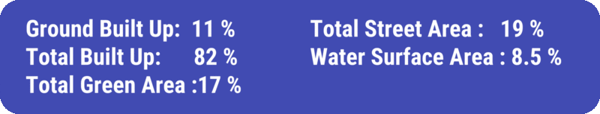
?
where in Mumbai
Selection of Focus area for prototype testing
More Built Up Ground Area ∝ Less permeable surface ∝ Increased Surface Runoff
Notes:
Using Geopandas we mapped out the other criterias rather than just the level of flooding, the first once being the built up ground area which mean less permeable surface hence increased runoff.Below we rank them from the highest to the lowest.

Slide 30
?
where in Mumbai
Selection of Focus area for prototype testing
More total Built Up Area ∝ Higher population density ∝ more stress on older grey infrastructure
Notes:
Then we looked at the total built up area, which being more is proportional to higher population density which means more stress on the older grey infrastructure.

Slide 31
?
where in Mumbai
Selection of Focus area for prototype testing
More Green Area ∝ Less surface runoff
Notes:
Then into the total green area, as more green area is less surface runoff

Slide 32
?
where in Mumbai
Selection of Focus area for prototype testing
More Street Area ∝ More surface runoff
Notes:
More street area also means more surface runoff

Slide 33
?
where in Mumbai
Selection of Focus area for prototype testing
More Water Area ∝ Less surface runoff
Notes:
Whereas more water area means less surface runoff because of the water bosy as well as permeable surfaces around it

Slide 34
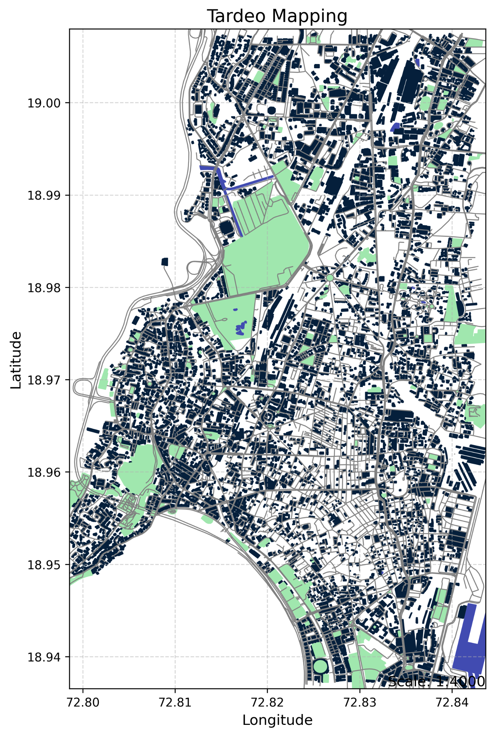

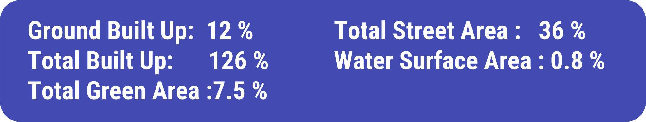
?
where in Mumbai
Tardeo
Notes:
And that is when we concluded that Tardeo is the best “worst” hotspot to test our proposal.

Slide 35
?
where in Mumbai
Tardeo
Notes:
And that is when we concluded that Tardeo is the best “worst” hotspot to test our proposal.

Slide 36
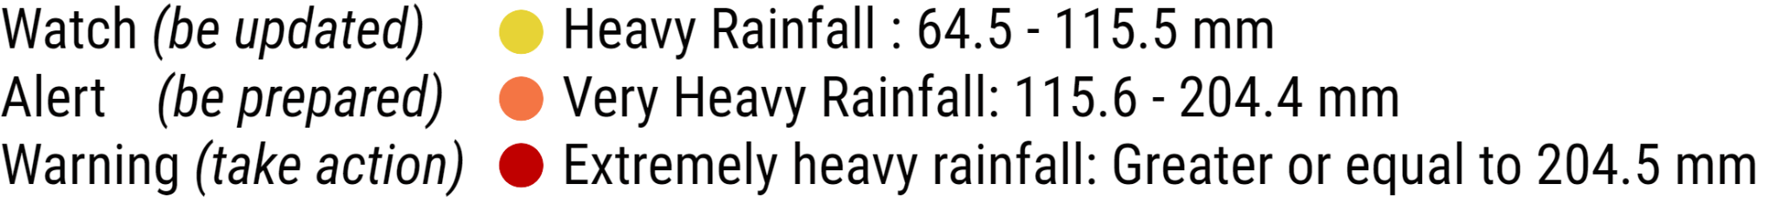
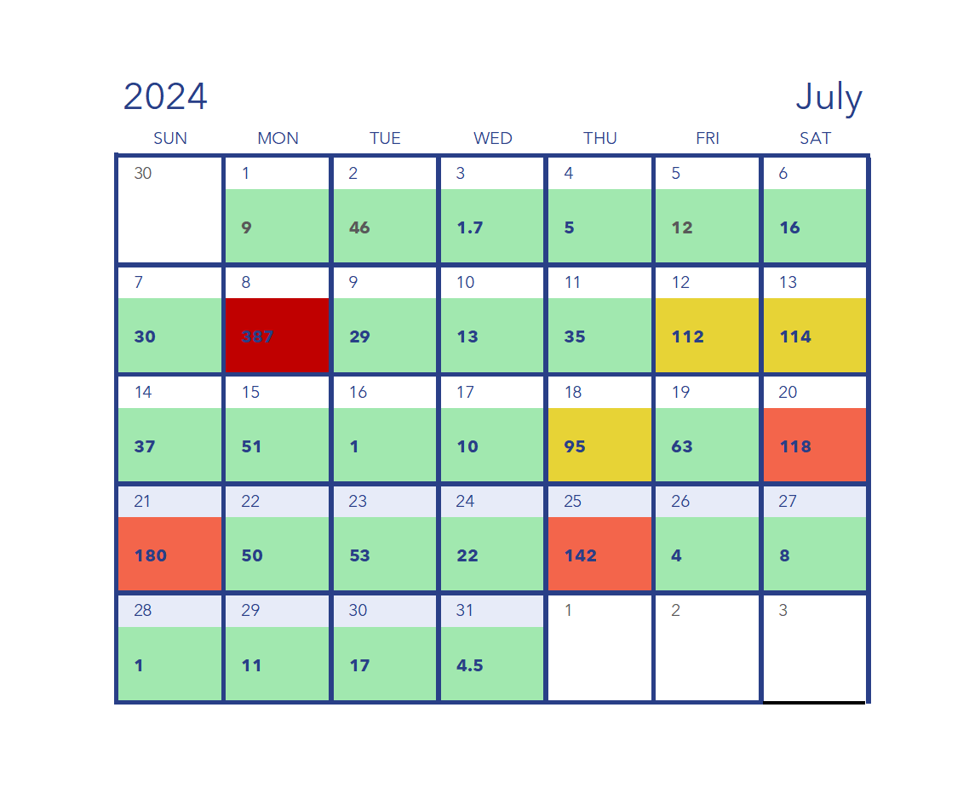
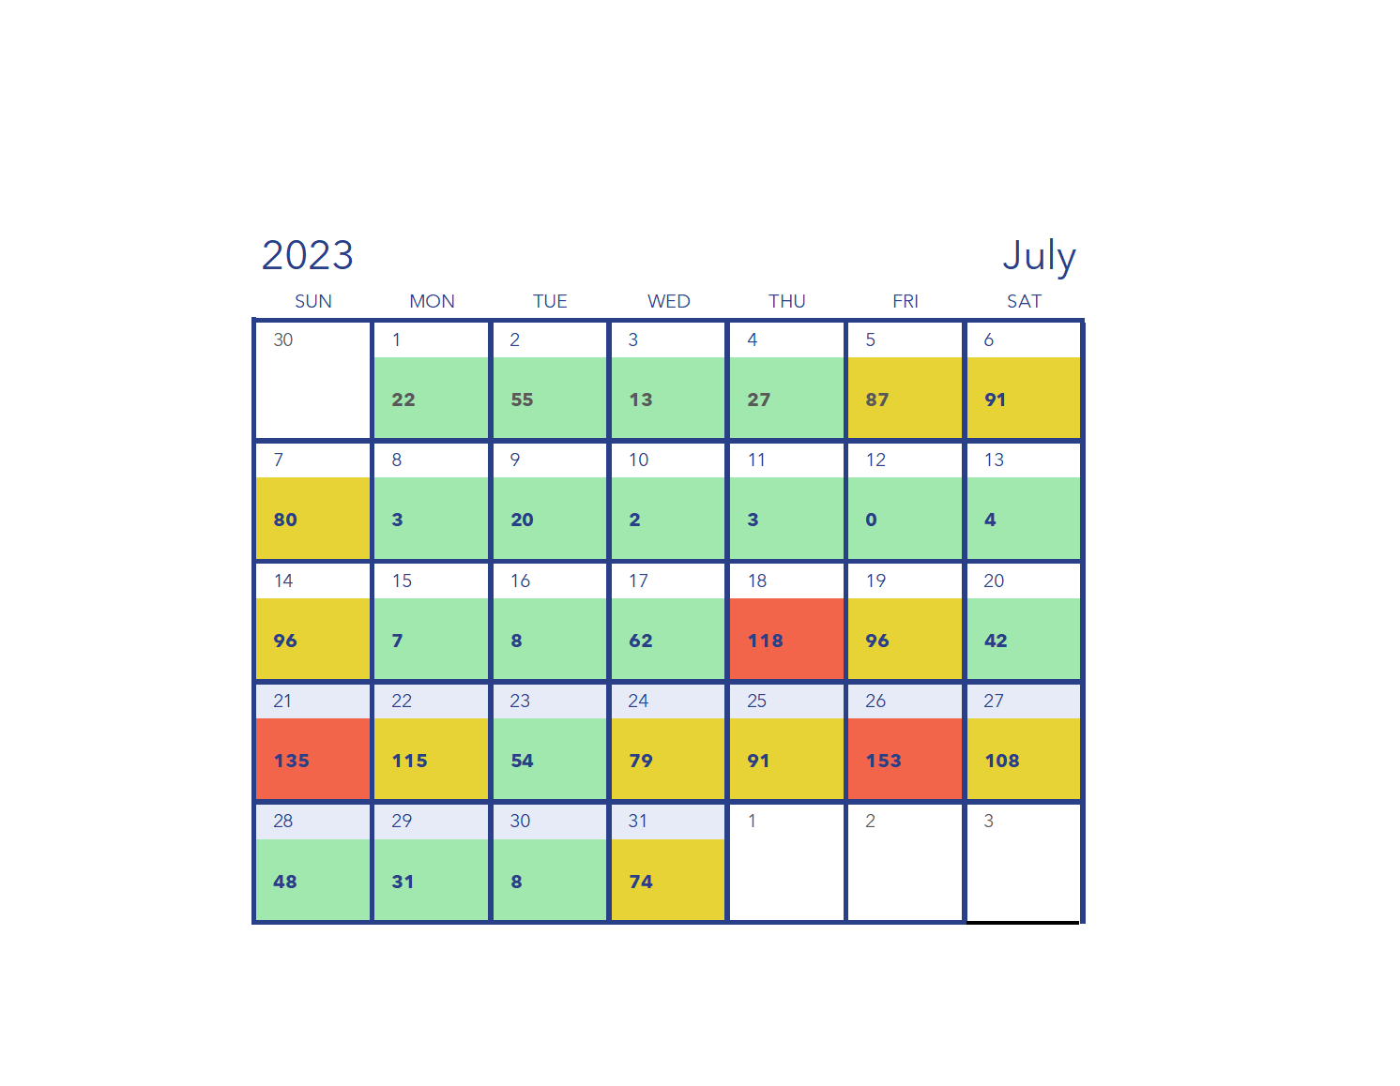
Micro- level Impact
Reduction of bad days in Tardeo
20 days floodings out of 60 days of rainfall.
Notes:
For the reduction of bad days, we mapped out the rainfall received as per the local weather station, the colouring represents the different alerts as per the Mumbai disaster guidelines, though they advise taking action when the rainfall is above 204.5mm, the last time Tardeo flooded rainfall was just 80mm, which means that in the past 2 years, 20 days would have been flooded in the area.

Slide 37
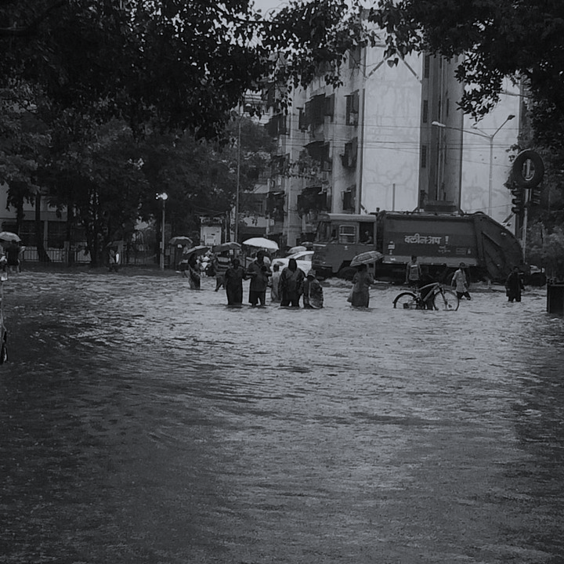
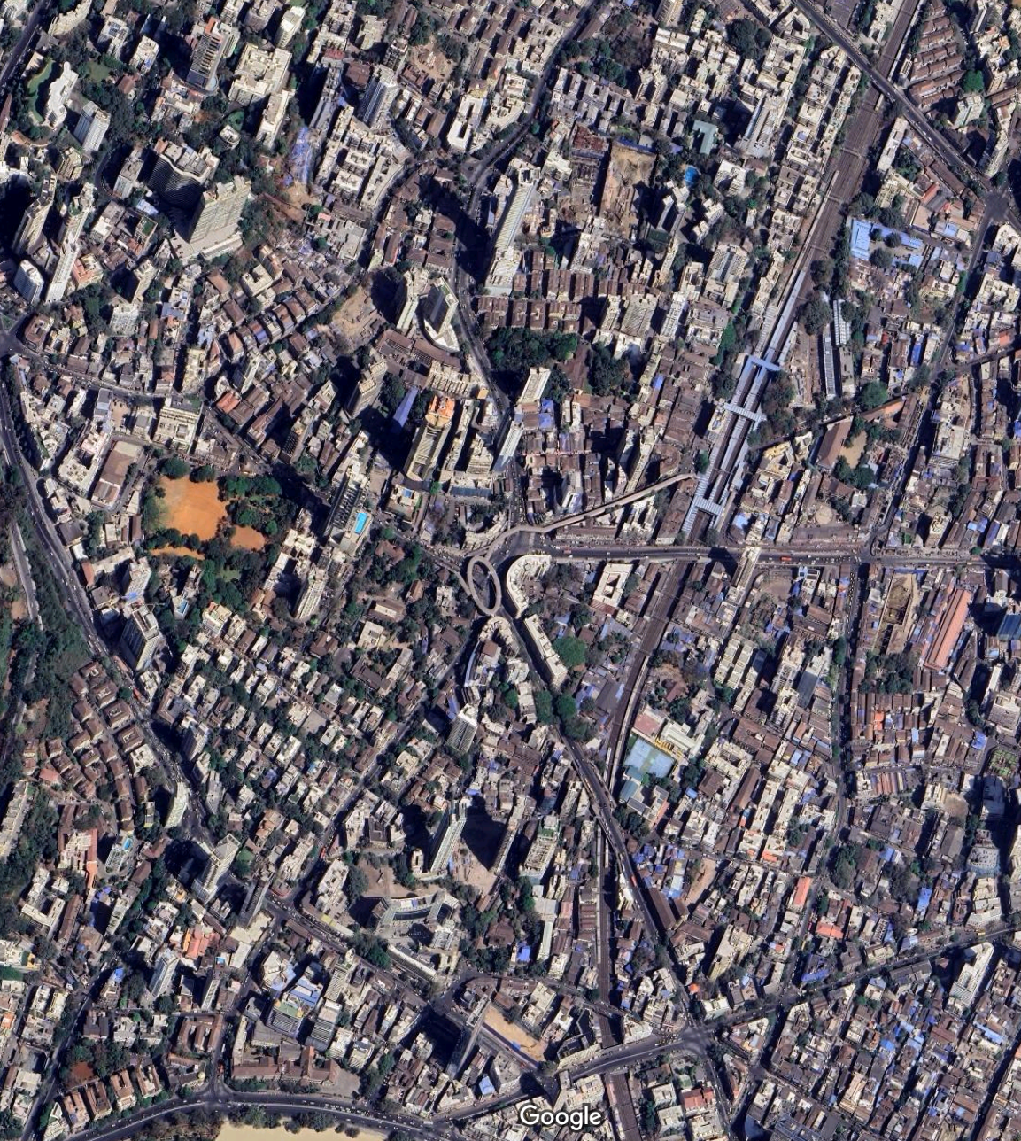

Micro- level Impact
Reduction of bad days in Tardeo
Input Values
Total region area: 785398 sqm (500 m radius)
Total Green Area: 33234.95 sqm
Total Street Area: 201410.4 sqm
Notes:
So we took the flooded square!!!! as the center and evaluated the region area with 500m radius and had the following inputs.

Slide 38

Micro- level Impact
Reduction of bad days in Tardeo
SIGNIFICANT IMPROVEMENT
PREVENTION
Notes:
Within this radius we mapped the building with its roof obstructions as accurately as we could and from it we saw the different percentage of green roof result in what percentage of surface runoff reduced.Though there is no one exact value ,!!!! a reduction in surface runoff from 20-30% can significantly improve the stormwater management in flood prone areas as this helps mitigate the impact of sudden rain events but for prevention of frequent flooding 40-50% is ideal to cope with the rapid influx of water.

Slide 39

Nana Chowk, Tardeo
Nana Chowk, 500 m radius region
SIGNIFICANT IMPROVEMENT
PREVENTION
Notes:
Within this radius we mapped the building with its roof obstructions as accurately as we could and from it we saw the different percentage of green roof result in what percentage of surface runoff reduced.Though there is no one exact value ,!!!! a reduction in surface runoff from 20-30% can significantly improve the stormwater management in flood prone areas as this helps mitigate the impact of sudden rain events but for prevention of frequent flooding 40-50% is ideal to cope with the rapid influx of water.

Slide 40

Future Possibilities
what next
Notes:
We see that for a thorough prevention of floods in this hotspot we would require all roofs to be green, which is a very idealistic scenario !!!!and hence for our further exploration we would broadened our research to look into the untapped street area which is 48% of the total neighbourhood area.

Slide 41





Analyze Road Intersections
Iso-Vist to get Tensile Surface
Simulate rain water
Direction
Average Point
Kangaroo Physics
Notes:
And this is our trial for a tensile structure where we can redirect or contain water in these open street areas.

Slide 42
Further inclusions:
Conclusion:
Including an adaptive solution to pitched roofs.
Including an adaptive solution to large open street spots like street intersections and crossings, would greatly impact the reduction of runoff through the non-built areas.
The integration of green infrastructure, permeable surfaces, and innovative materials has proven to be a crucial component in minimizing surface runoff and easing the burden on existing stormwater systems.
Thank you!

